Slide 1

Algorithms and Data Structures 1 CS 0445
Fall 2023
ADT Stack
Sherif Khattab
ksm73@pitt.edu
(Slides are adapted from Dr. Ramirez’s and Dr. Farnan’s CS1501 slides.)

Slide 2
Announcements
Upcoming Deadlines:
Programming Assignment 1: Friday 9/29 @ 11:59 pm
Homework 5: Tuesday 10/3 @ 11:59 pm
Assignment 1 Support Video available on Canvas

Slide 3
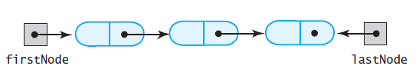
LList with Head and Tail references
A linked chain with both a head reference and a tail reference

Slide 4
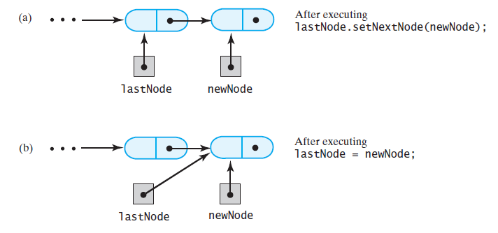
Adding to the end of an LList
Adding a node to the end of a nonempty chain that has a tail reference

Slide 5
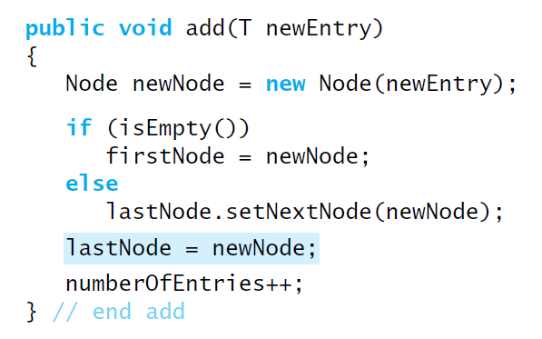
Adding to the end of an LList
Revision of the first add method

Slide 6
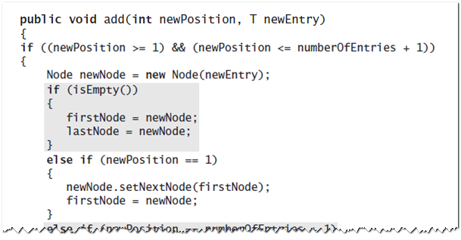
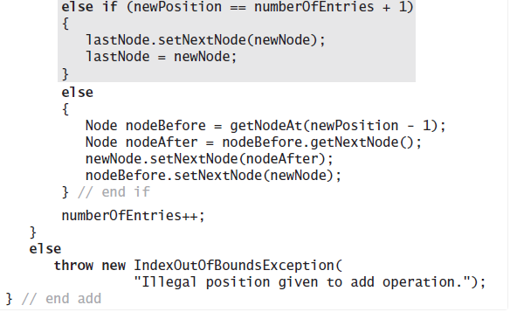
Adding at a specific position

Slide 7
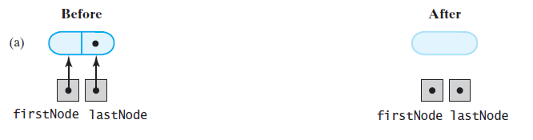
Removing from an LList with head and tail references
Removing the last when the chain contains one node

Slide 8
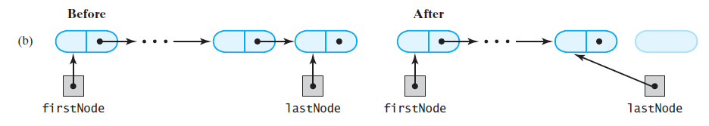
Removing from an LList with head and tail references
Removing the last when the chain contains more than one node

Slide 9
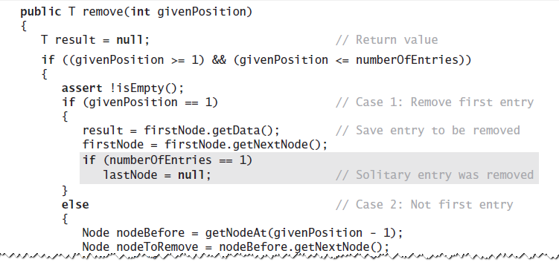
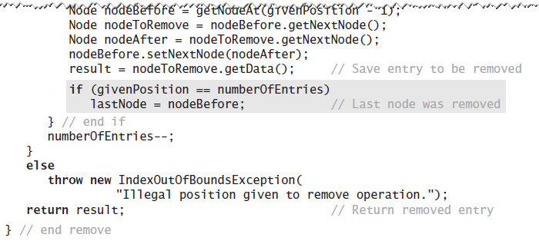
A Refined Implementation

Slide 10
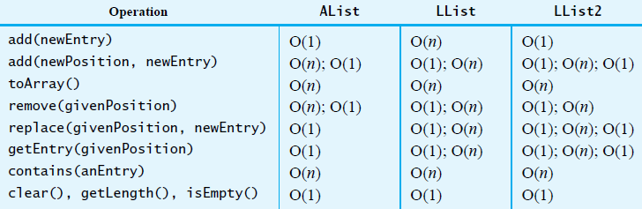
Efficiency of Using a Chain
beginning of list
end of list
middle of list

Slide 11
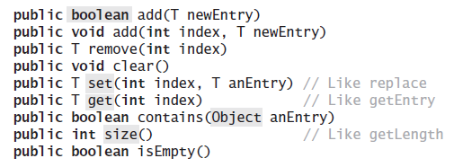
Java Class Library: The Interface List
Method headers from the interface List

Slide 12
Java Class Library: The Class Vector
Constructors
Has methods to add, remove, clear
Also methods to determine
Last element
If the vector empty
Number of entries

Slide 13
Java Class Library: The Class ArrayList
Available constructors
public ArrayList()
public ArrayList(int initialCapacity)
Similar to java.util.vector
Can use either ArrayList or Vector as an array-based implementation of the interface List

Slide 14
Java Class Library: The Class LinkedList
Implements the interface List
LinkedList defines more methods than are in the interface List
You can use the class LinkedList as implementation of ADT
Queue (first-in-first-out)
Deque (double-ended queue)
or List

Slide 15
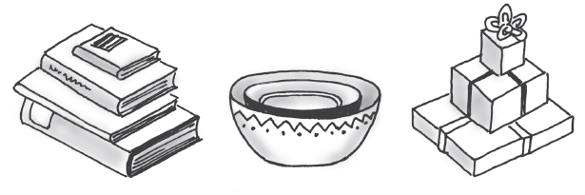
Stacks
Some familiar stacks
Add item on top of stack
Can only remove topmost item
Last In, First Out (LIFO)
First In, Last Out (FILO)
Items removed in reverse chronological order

Slide 16
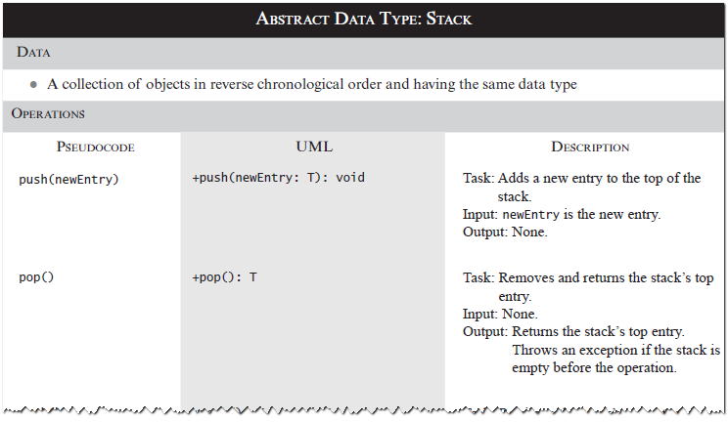
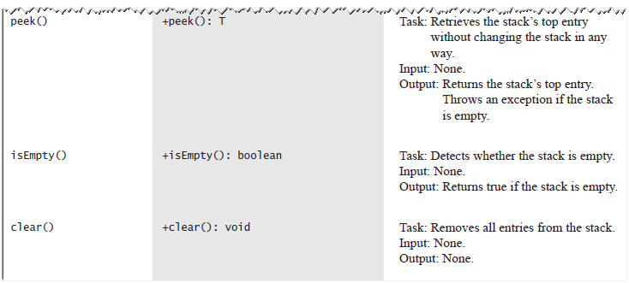
Specifications of the ADT Stack
Check StackInterface.java

Slide 17
Design Decision
When stack is empty
What to do with pop and peek?
Possible actions
Assume that the Stack is not empty
Return null
Throw an exception (which type?)
Can use java.util.EmptyStackException
or define our own Exception class

Slide 18
Design guidelines for Interfaces
Use preconditions and postconditions to document assumptions
Do not trust client to use public methods correctly
Avoid ambiguous return values
Prefer throwing exceptions instead of returning values to signal problem

Slide 19
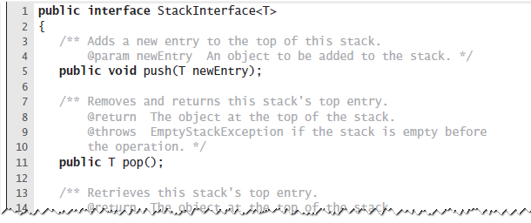
Interface for ADT Stack

Slide 20
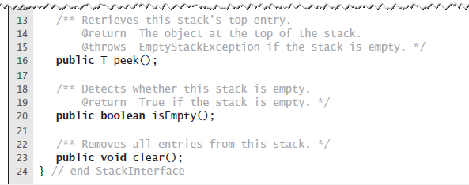
Interface
An interface for the ADT stack

Slide 21
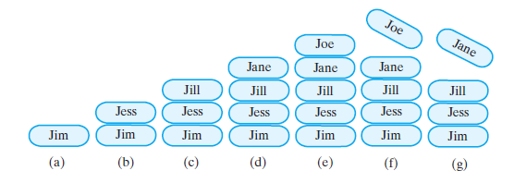
Example
push Jim
push Jess
push Jill
push Jane
push Joe
pop
pop

Slide 22
Array-Based Implementation
Each operation involves top of stack
push
pop
peek
End of the array easiest to access
Let this be top of stack
Let first entry be bottom of stack

Slide 23
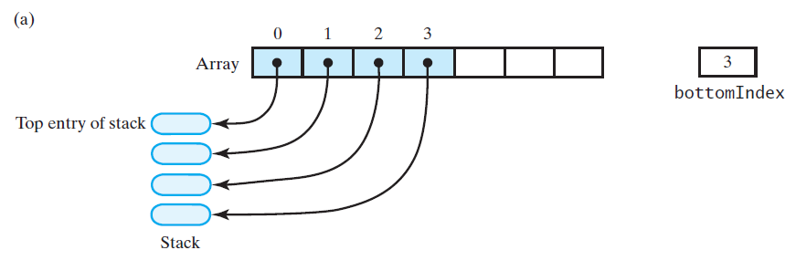
In-efficient Implementation
An array that implements a stack; its first location references (a) the top entry in the stack;

Slide 24
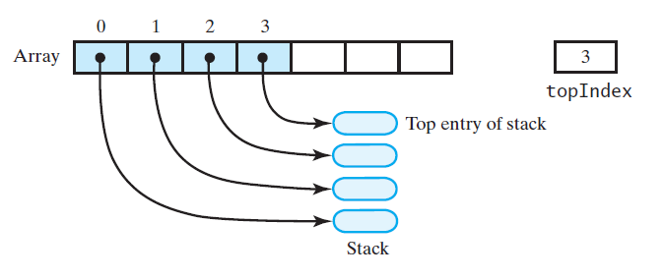
Efficient Array-Based Implementation
An array that implements a stack; its first location references (b) the bottom entry in the stack
(b)

Slide 25
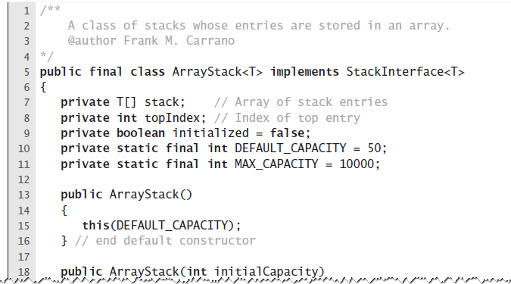
Array-Based Implementation
An outline of an array-based implementation of the ADT stack

Slide 26
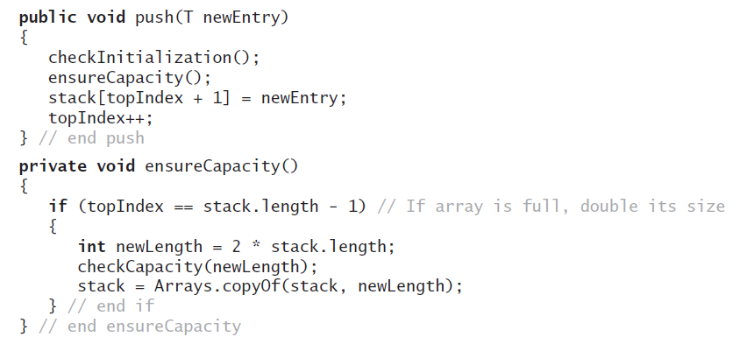
Array-Based Implementation
Adding to the top.

Slide 27
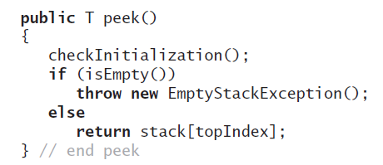
Array-Based Implementation
Retrieving the top, operation is O(1)

Slide 28
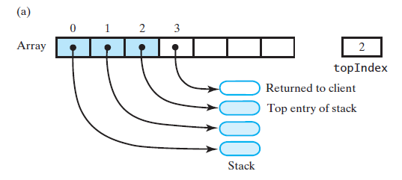
Array-Based Implementation
An array-based stack after its top entry is removed by (a) decrementing topIndex;

Slide 29
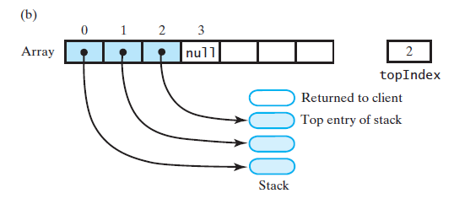
Array-Based Implementation
An array-based stack after its top entry is removed by (b) setting stack[topIndex] to null and then decrementing topIndex

Slide 30
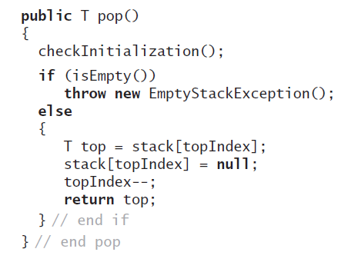
Array-Based Implementation
Removing the top

Slide 31
Linked Implementation
Each operation involves top of stack
push
pop
peek
Head of linked list easiest, fastest to access
Let this be the top of the stack

Slide 32
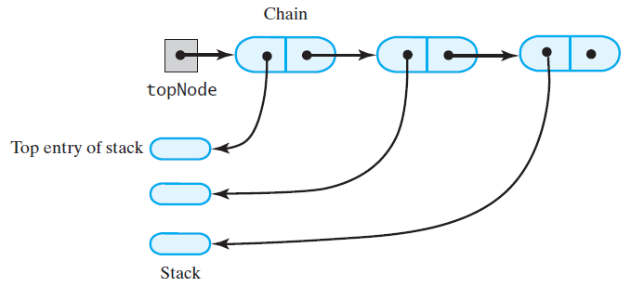
Linked Implementation
A chain of linked nodes that implements a stack

Slide 33
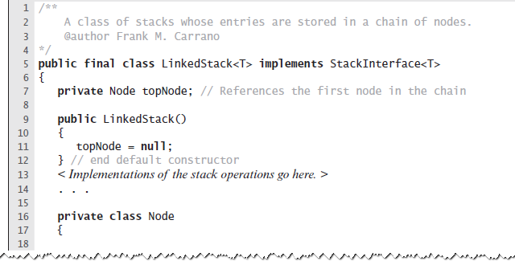
Linked Implementation
An outline of a linked implementation of the ADT stack

Slide 34
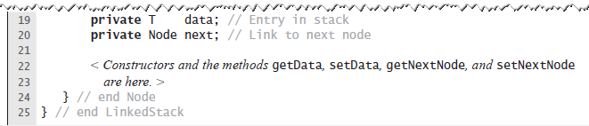
Linked Implementation
An outline of a linked implementation of the ADT stack

Slide 35
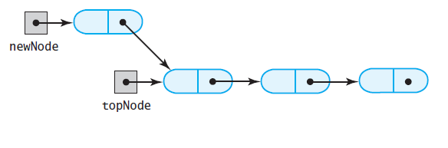
Linked Implementation
A new node that references the node at the top of the stack;
(a)

Slide 36
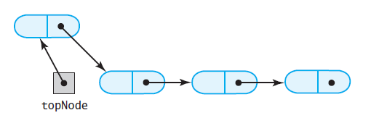
Linked Implementation
(b) the new node is now at the top of the stack
(b)

Slide 37
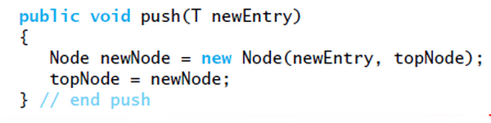
Linked Implementation
Definition of push

Slide 38
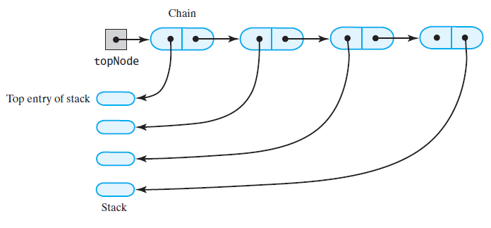
Linked Implementation
The stack before the first node in the chain is deleted
(a)

Slide 39
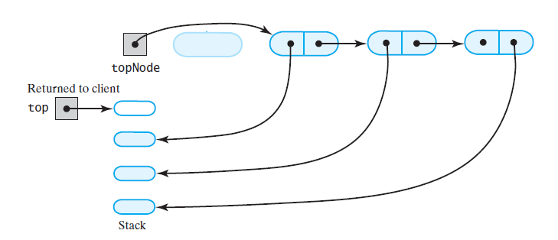
Linked Implementation
The stack after the first node in the chain is deleted
(b)

Slide 40
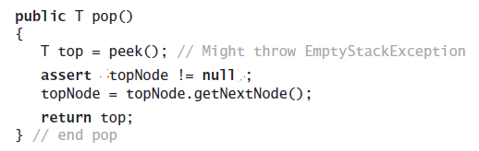
Linked Implementation
Definition of pop

Slide 41
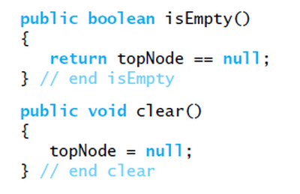
Linked Implementation
Definition of rest of class.

